Slide 1


Artificial Intelligence
ASHWANI CHAUDHARY
AIDS,DEPARTMENT

Slide 2

CHAPTER-1
Introduction

Slide 3
OutLine
Definition of an AI
Major Areas of Artificial Intelligence
AI Techniques, History
AI problems, Production Systems
Problem characteristics
Intelligent Agents
Agent Architecture,
AI Application (E-Commerce, & Medicine)
AI Representation
Properties of internal representation
Future scope of AI
Issues in the design of search algorithms
Production Systems

Slide 4
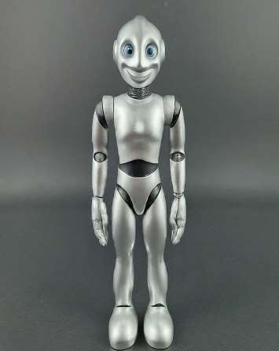
Introduction of an AI
Artificial Intelligence (AI) is the field of computer science that
aims to create intelligence machines capable of mimicking human cognitive functions such as learning and problem solving.
AI systems are designed to process information from the environment, learn from data and take actions that maximize their goals.

Slide 5
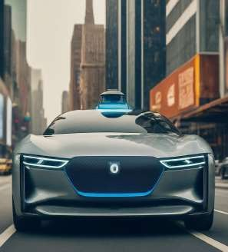
Application of AI
AI is revolutionizing various industries:
Self-driving cars: AI algorithms navigate roads and make
decisions in real-time.
Fraud detection: AI identifies suspicious patterns in
financial transactions.
Medical diagnosis: AI assists doctors in analyzing medical
images and data for accurate diagnoses.
Recommendation systems: AI personalizes product
recommendations based on user behavior.
Virtual assistants: AI-powered assistants like Siri and Alexa respond to voice commands and complete tasks.

Slide 6
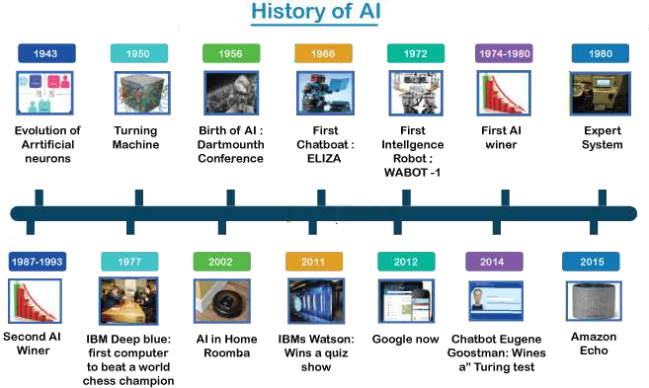
History of AI

Slide 7
Major Areas of Artificial Intelligence and Techniques
Artificial intelligence (AI) is a vast field encompassing various approaches and techniques
that enable machines to exhibit intelligent behavior.
Here are some of the major areas of AI research:
Machine Learning
Deep Learning
Natural Language Processing
Computer Vision
Robotics

Slide 8

1.Machine Learning
Machine learning is a subfield of AI where algorithms learn from data without explicit programming. They can identify patterns, make predictions, and improve their performance over time. Machine learning algorithms are trained on large datasets and can be categorized into three main types:
Supervised Learning: Involves learning from labeled data, where each data point has a corresponding label or output value. The algorithm learns the mapping between the input data and the desired output.
Unsupervised Learning: Deals with unlabeled data, where the algorithm must identify
patterns and relationships in the data on its own.
Reinforcement Learning: Involves an agent interacting with an environment and learning
through trial and error. The agent receives rewards for desired actions and penalties for
undesired actions, enabling it to learn optimal behavior over time.

Slide 9

2.Deep Learning
Deep learning is a subset of machine learning that uses artificial neural networks inspired by the structure and function of the human brain. These artificial neural networks consist of interconnected nodes (artificial neurons) arranged in layers.
Deep learning models can learn complex patterns from large amounts of data, achieving high levels of accuracy in tasks like:

Slide 10
Cont…..
Image Recognition: Recognizing objects and scenes in images with high accuracy.
Speech Recognition: Converting spoken language into text.
Machine Translation: Translating text from one language to another.
Natural Language Processing: Enabling machines to understand and respond to natural
language more effectively.

Slide 11


3. Natural Language Processing (NLP)
Natural Language Processing (NLP) is a subfield of AI concerned with the interaction between computers and human language. NLP techniques enable machines to understand, generate, and manipulate human language. Some key NLP tasks include:
Machine Translation: Automatically translating text from one language to another.
Text Summarization: Generating a concise summary of a lengthy Piece of text.
Sentiment Analysis: Identifying the emotional tone of a
piece of text (positive, negative or neutral). Chatbots: Creating conversational agents that interact with humans in a natural way.

Slide 12

4. Computer Vision
Computer vision is a field of AI that deals with the extraction of information from digital images and videos. Computer vision algorithms can:
Object detection: Identifying and locating objects within images or videos.
Image classification: Categorizing images based on their content.
Facial recognition: Identifying people in images or videos.
Medical image analysis: Assisting doctors in analyzing medical images
for diagnosis and treatment planning.

Slide 13
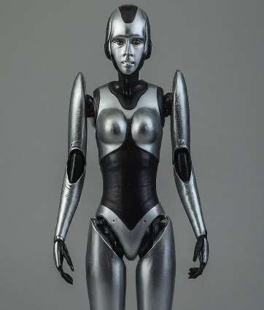

5. Robotics
Robotics is a field of engineering concerned with the design, construction, operation, and application of robots.
AI plays a crucial role in robotics by enabling robots to: Navigate their environment: Perceiving their surroundings and planning their movements. Interact with objects: Grasping and manipulating objects in a precise way.
Learn and adapt: Continuously improving their performance based on new experiences.

Slide 14
Intelligent Agents in AI
Intelligent agents are autonomous entities which observe their environment through sensors and act upon that environment using actuators (effectors) to achieve specific goals.
They can be simple, like a sensor, complex, a self-driving car. The fundamental
aspects of intelligent include:
Autonomy: The ability to operate without human intermediation.
Perception: Using sensors to collect data from the environment.
Influence: Performing actions in the environment.
Goal directed behavior: Taking actions aimed at achieving specific objectives.
Learning: Adjusting based on experiences and new data.

Slide 15
Types of Agents in AI
Simple Reflex Agents: Act only based on the current percept, ignoring the rest of the percept history.
Example: A vacuum cleaner that cleans when it senses direct.
Model-Based Reflex Agents: Maintain an internal state to track aspects of the
world not immediately understandable.
Example: A self-driving car that keeps track of its environment and past states.
Goal Based Agents: Act to achieve specific goals, taking into account future
states resulting from actions.
Example: A robot navigating a maze to reach the exit.

Slide 16
Cont……
Utility Based agents: choose actions based on a utility function to maximize the expected utility.
Example: A stock trading bot that sells to maximize profit.
Learning Agents: Improve their performance over time based on experience. Example: A recommendation system that improves its suggestions as it learns user preferences.

Slide 17
Implementation Aspects
Implementing intelligent agents involves several key aspects: Perception: Utilizing sensors and data processing algorithms to gather and interpret environmental data.
Action Selection: Using decision-making algorithms to choose actions that achieve
the agent’s goals.
Learning: Employing machine learning techniques to improve performance over
time.
Communication: Enabling agents to communicate with other agents or humans. Ethics and Safety: Ensuring agents operate within ethical guidelines and prioritize safety.

Slide 18
Applications of Intelligent Agents
Robotics: Autonomous robots in manufacturing, healthcare, and
exploration.
Finance: Trading bots that execute transactions in financial markets.
Healthcare: Diagnostic tools and personalized treatment planning.
Gaming: Non-player characters (NPCs) with realistic behaviors. Smart Homes: Systems that automate and optimize home environments.

Slide 19

AI Problem
AI problems can be broadly categorized into two main areas: technical challenges and ethical considerations.
1.Lack of transparency and explainability: Complex AI systems can be difficult to understand and interpret, making it challenging to determine how decisions are being made.This can be a problem in areas where accountability is important, such as healthcare or criminal justice.

Slide 20
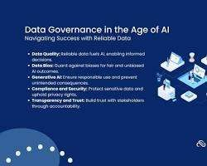
Cont……
2.Data quality and bias: AI systems are only as good as the data they are trained on. If the data is biased, the AI system will also be biased. This can lead to discrimination against certain groups of people.

Slide 21
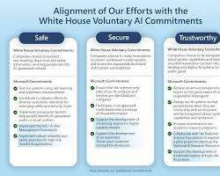
Cont……
3.Safety and security: AI systems can be vulnerable hacking and other security threats. Malicious actors cou potentially use AI to cause harm, such as by launchi cyberattacks or spreading misinformation.

Slide 22

Cont……
4.Job displacement: AI has the potential to automate many jobs, leading to job loss and a need for reskilling.

Slide 23

Cont……
5. Privacy Concerns: AI systems can collect and use a lot of personal data. This raises concerns about privacy and the potential for misuse of this data.

Slide 24
Defining Problems as a State Space Search
A Powerful Problem-Solving Technique
In Artificial Intelligence (AI), state space search is a fundamental approach for solving problems.
It involves modeling the problem as a collection of possible states, along with the actions that can transition between them.
The goal is to find a sequence of actions that leads from the starting state (initial
state) to a state that satisfies the desired outcome (goal state).

Slide 25
Cont…..
Key Components of a State Space Search
State Space:
This represents the set of all possible configurations or situations the problem can be in.
Each state is a snapshot of the problem at a specific point in time.
Examples: A Rubik's cube in a particular configuration, a game board layout in chess, a
city on a map during route planning.
Initial State:
This defines the starting point of the search, the state from which the solution path begins.
Examples: The scrambled state of the Rubik's cube, the starting position of the pieces in
chess, the starting city in route planning.

Slide 26
Cont…..
Goal State(s):
This defines the desired outcome(s) of the problem. One or more states that meet the success criteria.
Examples: The solved state of the Rubik's cube, a checkmate position in chess, the destination city in
route planning.
Actions:
These are the operations or decisions that can be taken to transition from one state to another.
Examples: Rotating a face of the Rubik's cube, moving a piece in chess, choosing a road to travel on
in route planning.

Slide 27
Cont…..
Successor Function:
This function takes a current state as input and returns all the possible states that can be reached by applying a single action.
Essentially, it outlines the valid transitions between states.
Cost Function (Optional):
This function assigns a numerical cost to each action or state transition.
It allows for finding the most efficient solution path when there are multiple paths to the
goal state.
Examples: Distance traveled in route planning, time taken for a move in chess.

Slide 28
Cont…..
Benefits of State Space Search
Systematic approach:
It explores the problem
space systematically, ensuring all possibilities are
considered.
Flexibility:
Applicable to various AI problems by defining appropriate states, actions, and goals.
Foundation for algorithms:
Forms the basis for many search algorithms used in AI, like Breadth-First Search,
Depth-First Search, and A* Search.

Slide 29
Cont…..
Challenges of State Space Search
Complexity:
Can be computationally expensive for problems with large state spaces (e.g., complex games like chess).
Heuristic design (informed search):
Designing effective heuristic functions to guide the search towards the goal is crucial for informed search algorithms.
Overall, defining problems as a state space search provides a powerful framework for solving problems
in AI.
By understanding the components and considering the challenges, you can effectively apply this technique to various AI applications.

Slide 30
Problem Characteristics
AI problems come in many flavors, and unlike neatly defined math problems, they often have characteristics that make them challenging to solve. Here's a breakdown of some key characteristics of problems in AI:
Complexity: Many AI problems involve vast amounts of data and intricate relationships between
variables.
Imagine training an image recognition system - it has to deal with millions of images, each with
countless pixels and variations in lighting, pose, and background.
Uncertainty and Ambiguity: Real-world data is rarely perfect. Sensor readings can be noisy,
information might be incomplete, and the boundaries between categories can be blurry.
An AI for self-driving cars needs to handle unexpected situations on the road, like unclear lane
markings or sudden weather changes.

Slide 31
Problem Characteristics
AI problems come in many flavors, and unlike neatly defined math problems, they often have characteristics that make them challenging to solve. Here's a breakdown of some key characteristics of problems in AI:
Complexity: Many AI problems involve vast amounts of data and intricate relationships between
variables.
Imagine training an image recognition system - it has to deal with millions of images, each with
countless pixels and variations in lighting, pose, and background.
Uncertainty and Ambiguity: Real-world data is rarely perfect. Sensor readings can be noisy,
information might be incomplete, and the boundaries between categories can be blurry.
An AI for self-driving cars needs to handle unexpected situations on the road, like unclear lane
markings or sudden weather changes.

Slide 32
Cont……
Non-linearity:
In many AI problems, the cause-and-effect relationships aren't straightforward.
Small changes in the input can lead to significant changes in the output. Developing an AI for stock market prediction requires dealing with complex interactions between economic factors, news events, and investor behavior.
Dynamism:
The world around us is constantly changing. An AI system needs to adapt to new information and situations.
A spam filter, for example, needs to continuously learn to identify new spam
tactics used by malicious actors.

Slide 33
Cont……
Context Sensitivity:
The meaning of data can depend on the context in which it appears.
An AI for sentiment analysis needs to understand the nuances of language, like sarcasm or
humor, to determine the true sentiment of a text.
Subjectivity:
Concepts like beauty, fairness, or humor can be subjective and vary depending on the
individual or culture.
An AI for image captioning needs to account for these subjective interpretations when
generating captions.

Slide 34
Cont……
Interactivity:
Some AI problems involve interaction with the environment.
An AI for a game playing agent needs to consider the actions of its opponent and adapt its strategy accordingly.
Multidisciplinary Expertise:
Solving complex AI problems often requires collaboration between computer scientists,
mathematicians, psychologists, linguists, and domain experts.

Slide 35
Cont……
Ethical Considerations: As AI becomes more powerful, ethical considerations become
paramount.
Biases in training data can lead to discriminatory AI systems. The development and deployment of AI need to be done responsibly, considering fairness, transparency, and accountability.
Understanding these characteristics is crucial for researchers and developers designing effective AI solutions.
By acknowledging the challenges and complexities, they can create algorithms that are
robust, adaptable, and address real-world problems.

Slide 36
Production Systems
Production rules in AI are a group of rules that apply to information
collected from a global database.
Each rule has a precondition and a postcondition that the global database must either fulfill or not, depending on the rule.

Slide 37
How its Works
Input: The system receives some input data representing the current situation.
Matching: The inference engine compares the input data to the conditions in the production rules.
Firing: If a rule's condition matches the input data, the rule is fired, and the corresponding action is taken. This action may involve modifying the system's internal state, generating an output, or even firing other rules.
Iteration: The process continues iteratively until no more applicable rules are
found or a specific goal is achieved.

Slide 38
Applications
Production systems are used in various AI applications, including:
Expert Systems: These systems capture the knowledge of human experts in a
specific domain and use it to solve problems, diagnose diseases advice.
Medical Diagnosis: AI systems can analyze patient data and medical history using production rules to suggest potential diagnoses.
Game Playing: AI players in games like chess or checkers use production rules
to evaluate the game state and make optimal moves.
Robotics Control: Robots can use production rules to react to their environment
and make decisions about their actions.

Slide 39
Issues in the design of search algorithms
Search algorithms play a essential role in numerous artificial intelligence applications, surrounding planning, game playing and machine learning.
The effectiveness of a search algorithm centers on various factors, including the nature of the search problem, available resources, and desired solution characteristics.

Slide 40
Cont……
The Two Main Search Algorithm Classes
Uninformed Search Algorithms
Explore the search space systematically, present knowledge about the goal.
Examples: Breadth-First Search (BFS), Depth-First Search (DFS)
Informed Search Algorithms
Utilize domain-specific knowledge to drive the search near the goal.
Examples: Greedy Search, A* Search

Slide 41
Cont…..
Challenges in Uninformed Search
Completeness
Words finding a solution if one exists.
BFS is complete for most search problems.
DFS might not be complete due to infinite loops.
Optimality
Finds the solution with the lowest cost.
BFS is optimal for problems with uniform costs.
DFS might not find the optimal solution.

Slide 42


Cont…..
Considerations in Informed Search
Experiential Function Design
The quality of the experiential function significantly impacts performance.
A good experiential function should be permissible (never overestimate cost)
and consistent (always underestimate or estimate the exact cost).
Optimality vs. Efficiency
Informed search algorithms often skill optimality for efficiency.
A well-designed experiential function can significantly improve efficiency
without forgoing optimality.

Slide 43
Representation of AI
It consists of the objectives that are used to express the knowledge that is required to solve a specific problem.
The different kinds of knowledge that need to be represented in AI systems. include: Objects: All the information related to the objects present in our world.

Slide 44
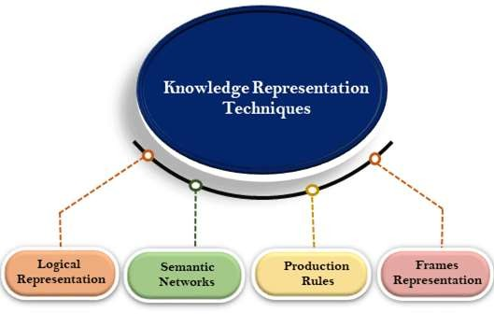

Cont….
Logical Representation:
Drawing a conclusion based on various conditions.
provides machines with the capacity for representing their
world and for logical reasoning.
Statements in propositional logic can be either True or false.
2.Semantic Networks:
AI are graphical structures designed to represent and organize knowledge, enabling machines to understand and process information in human-readable form.
words and sentences and using those details to perform tasks or
provide information to users.
For example, a semantic AI system can automatically summarize a news article, answer questions, or translate text from one language to another.

Slide 45
Cont….
Production Rules
Production rules in AI are a group of rules that apply to information collected from a global database.
Each rule has a precondition and a postcondition that the global database must either fulfill
or not, depending on the rule.
Frames Representation
A frame-based expert system is an (AI) program that uses a knowledge representation
technique to store and reason with facts about the world.
It works on the basis of frames, which are structures designed to capture relevant information from a particular domain such as medicine or business.

Slide 46

Properties of internal representation
Internal representation, also known as knowledge representation in AI, refers to
how information is stored and structured within an AI system.
This structure allows the AI to reason, learn, and solve problems.
Here are some key properties of a good internal representation in AI:
Representational Capability: The system should be able to represent all the necessary knowledge for the specific task or domain. It needs to capture the essential elements and relationships between them.
Inferential Capability: The representation should allow the AI to manipulate existing knowledge to derive new knowledge. This enables reasoning, logic, and making predictions based on the stored information.

Slide 47

Cont….
Inferential Efficiency: The system should facilitate efficient reasoning and manipulation of knowledge. This means the AI can save and use relevant information quickly to solve problems.
Acquisitional Efficiency: The knowledge representation scheme should allow for easy acquisition of new knowledge. This makes the system easy going and able to learn from new data.

Slide 48
Cont….
5. Descriptive Power: Ideally, the internal representation should be somewhat understandable by humans. This allows us to explain the AI's reasoning process and identify potential biases or errors in its logic.
These properties are essential for building effective AI systems. The choice of representation method depends on the specific task and the type of knowledge being distributed with. Some common internal representation techniques include logic statements, semantic networks, probabilistic models, and deep learning architectures.

Slide 49
Future Scope of AI
The future scope of artificial intelligence (AI) is vast and holds the potential to transform various aspects of society, industry, and daily life.
Here are some key areas

Slide 50
Cont…..
Healthcare
Personalized Medicine: AI can analyze genetic information, lifestyle data, and
medical records to modify treatments to individual patients.
Early Diagnosis: Machine learning models can detect diseases early by analyzing
medical images, genetic data, and other biomarkers.
Drug Discovery: AI speed up the process of discovering new drugs by predicting
how different compounds will interact with targets in the body.

Slide 51
Cont….. Transportation
Autonomous Vehicles: Continued advancements in AI will enhance
the safety, efficiency, and occurrence of self-driving cars, buses, and drones.
Traffic Management: AI can optimize traffic flow in cities, reducing overcrowding and productions by managing traffic lights and predicting traffic patterns.

Slide 52
Cont….. Education
Personalized Learning: AI-driven educational platforms can adapt
to the learning styles and paces of individual students, providing customized resources and feedback.
Administrative Automation: AI can handle administrative tasks, such as categorizing and scheduling, liberation educators to focus more on teaching.

Slide 53
Cont….. Finance
Fraud Detection: AI algorithms can identify unusual patterns and
behaviors that may indicate fake activities.
Algorithmic Trading: AI can analyze vast amounts of financial data to make trading decisions at speeds and accuracies beyond human capabilities.
Personal Finance Management: AI-driven applications can provide personalized advice on planning, saving, and investing.

Slide 54
Cont…..
Manufacturing
Predictive Maintenance: AI can predict equipment failures before they occur,
reducing downtime and maintenance costs.
Quality Control: Machine learning algorithms can detect defects in products at
various stages of the manufacturing process, ensuring higher quality outputs.
Supply Chain Optimization: AI can optimize supply chains by predicting
demand, managing list, and identifying the most efficient logistics ways.

Slide 55
Cont…..
Environmental Protection
Climate Modeling: AI can improve climate models by analyzing vast amounts of environmental data, leading to better predictions and strategies for combating climate change.
Nature Conservation: AI-driven tools can monitor nature populations, detect
activities, and help in the conservation of common species.
Energy Management: AI can optimize energy consumption in homes and industries, reducing waste and promoting the use of renewable energy sources.

Slide 56
Cont…..
Customer Service
Chatbots and Virtual Assistants: AI-powered chatbots and virtual assistants can handle customer inquiries, provide recommendations, and offer support, improving customer service efficiency.
Sentiment Analysis: AI can analyze customer feedback and social media to instrument public sentiment and improve products and services accordingly.

Slide 57
Cont…...
Entertainment
Content Creation: AI can assist in creating song, art, and literature, offering new
tools for artists and creators.
Personalized Recommendations: AI algorithms can suggest movies, music,
books, and other content personalized to individual preferences.

Slide 58
Smart Cities
Cont…...
Infrastructure Management: AI can optimize the use of
resources, manage utilities, and maintain infrastructure efficiently.
Public Safety: AI-driven surveillance systems can enhance public safety by monitoring for and answering to potential threats.

Slide 59
Cont….
AI Ethics and Governance
Ethical AI Development: As AI becomes more integrated into society, ensuring
ethical use and avoiding biases in AI systems will be important.
Regulation and Policy: Governments and organizations will need to develop policies and regulations to govern the use of AI, ensuring it benefits society while minimizing risks.

Slide 60
Application of AI (E-commerce & Medicine)
AI in e-commerce include personalized product recommendations, chatbots, virtual shopping assistants, dynamic evaluating, fraud detection and logistics optimization.
AI can also help analyze customer reviews to improve product design and marketing strategies.
E-commerce:
1.Personalization:
Product Recommendations: AI algorithms analyze browsing history, purchase behavior,
and preferences to recommend products personalized to individual users.
Personalized Marketing: AI can create customized marketing messages and offers based
on customer data, improving arrangement and conversion rates.

Slide 61
Cont…..
Customer Service:
Chatbots: AI-driven chatbots handle customer inquiries 24/7, providing instant responses
and solutions. They can handle common questions, track orders, and assist with returns.
Virtual Assistants: More advanced than chatbots, virtual assistants can offer more
personalized and context-aware assistance to customers.
List Management:
Demand Forecasting: AI can predict future product demand based on historical data,
trends, and external factors, helping businesses optimize inventory levels.
Automated Restocking: AI systems can automate the restocking process, ensuring
popular items are always available and reducing overstock of less popular items.

Slide 62
Cont…..
Evaluating Optimization:
Dynamic Pricing: AI algorithms adjust prices in real-time based on supply and demand, competitor pricing, and other factors, maximizing profits and competitiveness.
Personalized Pricing: AI can offer personalized discounts and pricing based on customer profiles and behavior.
Fraud Detection:
Transaction Monitoring: AI systems analyze transactions in real-time to detect
and prevent fraudulent activities by identifying unusual patterns and behaviors.

Slide 63
Cont……
Enhanced Search and Navigation:
Visual Search: AI-powered visual search allows users to search for products using
images rather than keywords, improving the shopping experience.
Natural Language Processing (NLP): AI enhances search functionality by understanding and processing user queries in natural language.

Slide 64
Application of AI in Medicine
Diagnostics:
Medical Imaging: AI algorithms analyze medical images (e.g., X-rays, MRIs,
CT scans) to detect abnormalities, such as tumors, fractures, or diseases, with
high accuracy.
Pathology: AI can assist in analyzing pathology slides to identify cancerous
cells and other pathological conditions.
Predictive Analytics:
Disease Prediction: AI models can predict the likelihood of developing certain diseases based on genetic, lifestyle, and environmental factors.
Patient Outcomes: AI can predict patient outcomes and potential complications, helping in early intervention and personalized treatment plans.

Slide 65
Cont…..
Personalized Medicine:
Genomics: AI analyzes genetic data to identify mutations and variations linked to specific diseases, aiding in the development of personalized treatment plans.
Treatment Optimization: AI helps in identifying the most effective treatments
for individual patients based on their genetic makeup and medical history.
Robotics and Automation:
Surgical Robots: AI-powered robots assist surgeons in performing complex procedures with precision and minimal invasiveness.
Automated Systems: AI automates routine tasks, such as dispensing medication, managing patient records, and scheduling appointments.

Slide 66
Cont…...
Telemedicine:
Remote Monitoring: AI enables remote monitoring of patients with chronic conditions, providing real-time data to healthcare providers.
Virtual Consultations: AI supports virtual consultations by analyzing patient data and assisting healthcare providers in diagnosis and treatment.
Drug Discovery and Development:
Molecular Analysis: AI accelerates drug discovery by analyzing molecular structures and predicting their effects on biological targets.
Clinical Trials: AI optimizes clinical trial design, patient recruitment, and data
analysis, reducing the time and cost of bringing new drugs to market.

Slide 67
Cont….
Health Management:
Wearable Devices: AI analyzes data from wearable devices to monitor vital signs, activity levels, and other health metrics, providing insights for preventive care.
Behavioral Health: AI applications in mental health analyze patterns in behavior
and speech to provide early warnings of conditions like depression and anxiety.

Slide 68
Cont….
Health Management:
Wearable Devices: AI analyzes data from wearable devices to monitor vital signs, activity levels, and other health metrics, providing insights for preventive care.
Behavioral Health: AI applications in mental health analyze patterns in behavior
and speech to provide early warnings of conditions like depression and anxiety.

Slide 69
References
Artificial Intelligence: A New Synthesis, Harcourt Publishers (Text Book) by N. J.
Nilsson / Harcourt Publishers.
Artificial Intelligence (Text Book) by Elaine Rich and Kevin Knight / TMH.
Artificial Intelligence Structures and Strategies for Complex Problem Solving by
George F. Luger / Pearson Education / PHI.
Artificial Intelligence A Practical Approach by Patterson / Tata McGraw Hill / 3.

Slide 70



www.paruluniversity.ac.in

